Slide 1








Food Prices and COVID-19 From Global and Local Perspectives
CSC440 Project
Speakers:
Chao Huang & Yufei Zhao

Slide 2
Content
Background
Dataset
Global Perspective
Local Perspective

Slide 3

01
Background

Slide 4

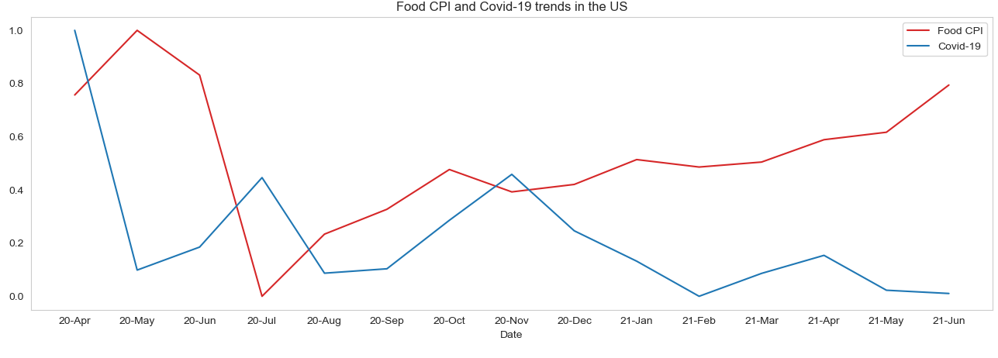
Background
Motivation
The Covid-19 has severely impacted people’s lives in the past two years. As a necessity to living, food price fluctuates intensely than before
It is worth investigating the correlation between food price changes and the situation of Covid-19, helping us better understand how people’s lives change
Take a glance at the food price – Covid 19 trends

Slide 5


Background
Problems
How does the food price of each food subcategories change before and during the COVID-19 pandemic?
How do consumers/households with different attributes change their shopping behaviors on food?
What are differences and similarities of the change in food price in countries with different political policies and security level?
Related Works
How did COVID-19 impact US household foods? An analysis in six month. Huang, K.M., Sant’Anna, AC., & Etienne, X. (2021). PLos ONE 16(9): e0256921.
The impact of COVID-19 on food prices in China: evidence of four major food products from Beijing, Shandong, and Hubei Provinces. Yu, X. & Liu, C. (2020). China Agricultural Economic Review. Vol.12 No.3, pp.445-458.

Slide 6
02
Dataset

Slide 7


Dataset
The dataset can be divided into three parts: the food price part, the COVID-19 part, and the household survey part.
▻ Food Price: Consumer Price Index (CPI)
▻ COVID-19: confirmed cases and confirmed death
▻ Household Survey: spending on food of different groups

Slide 8
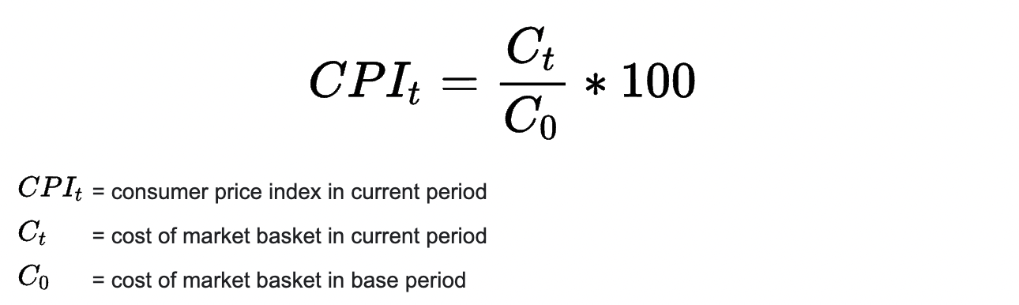
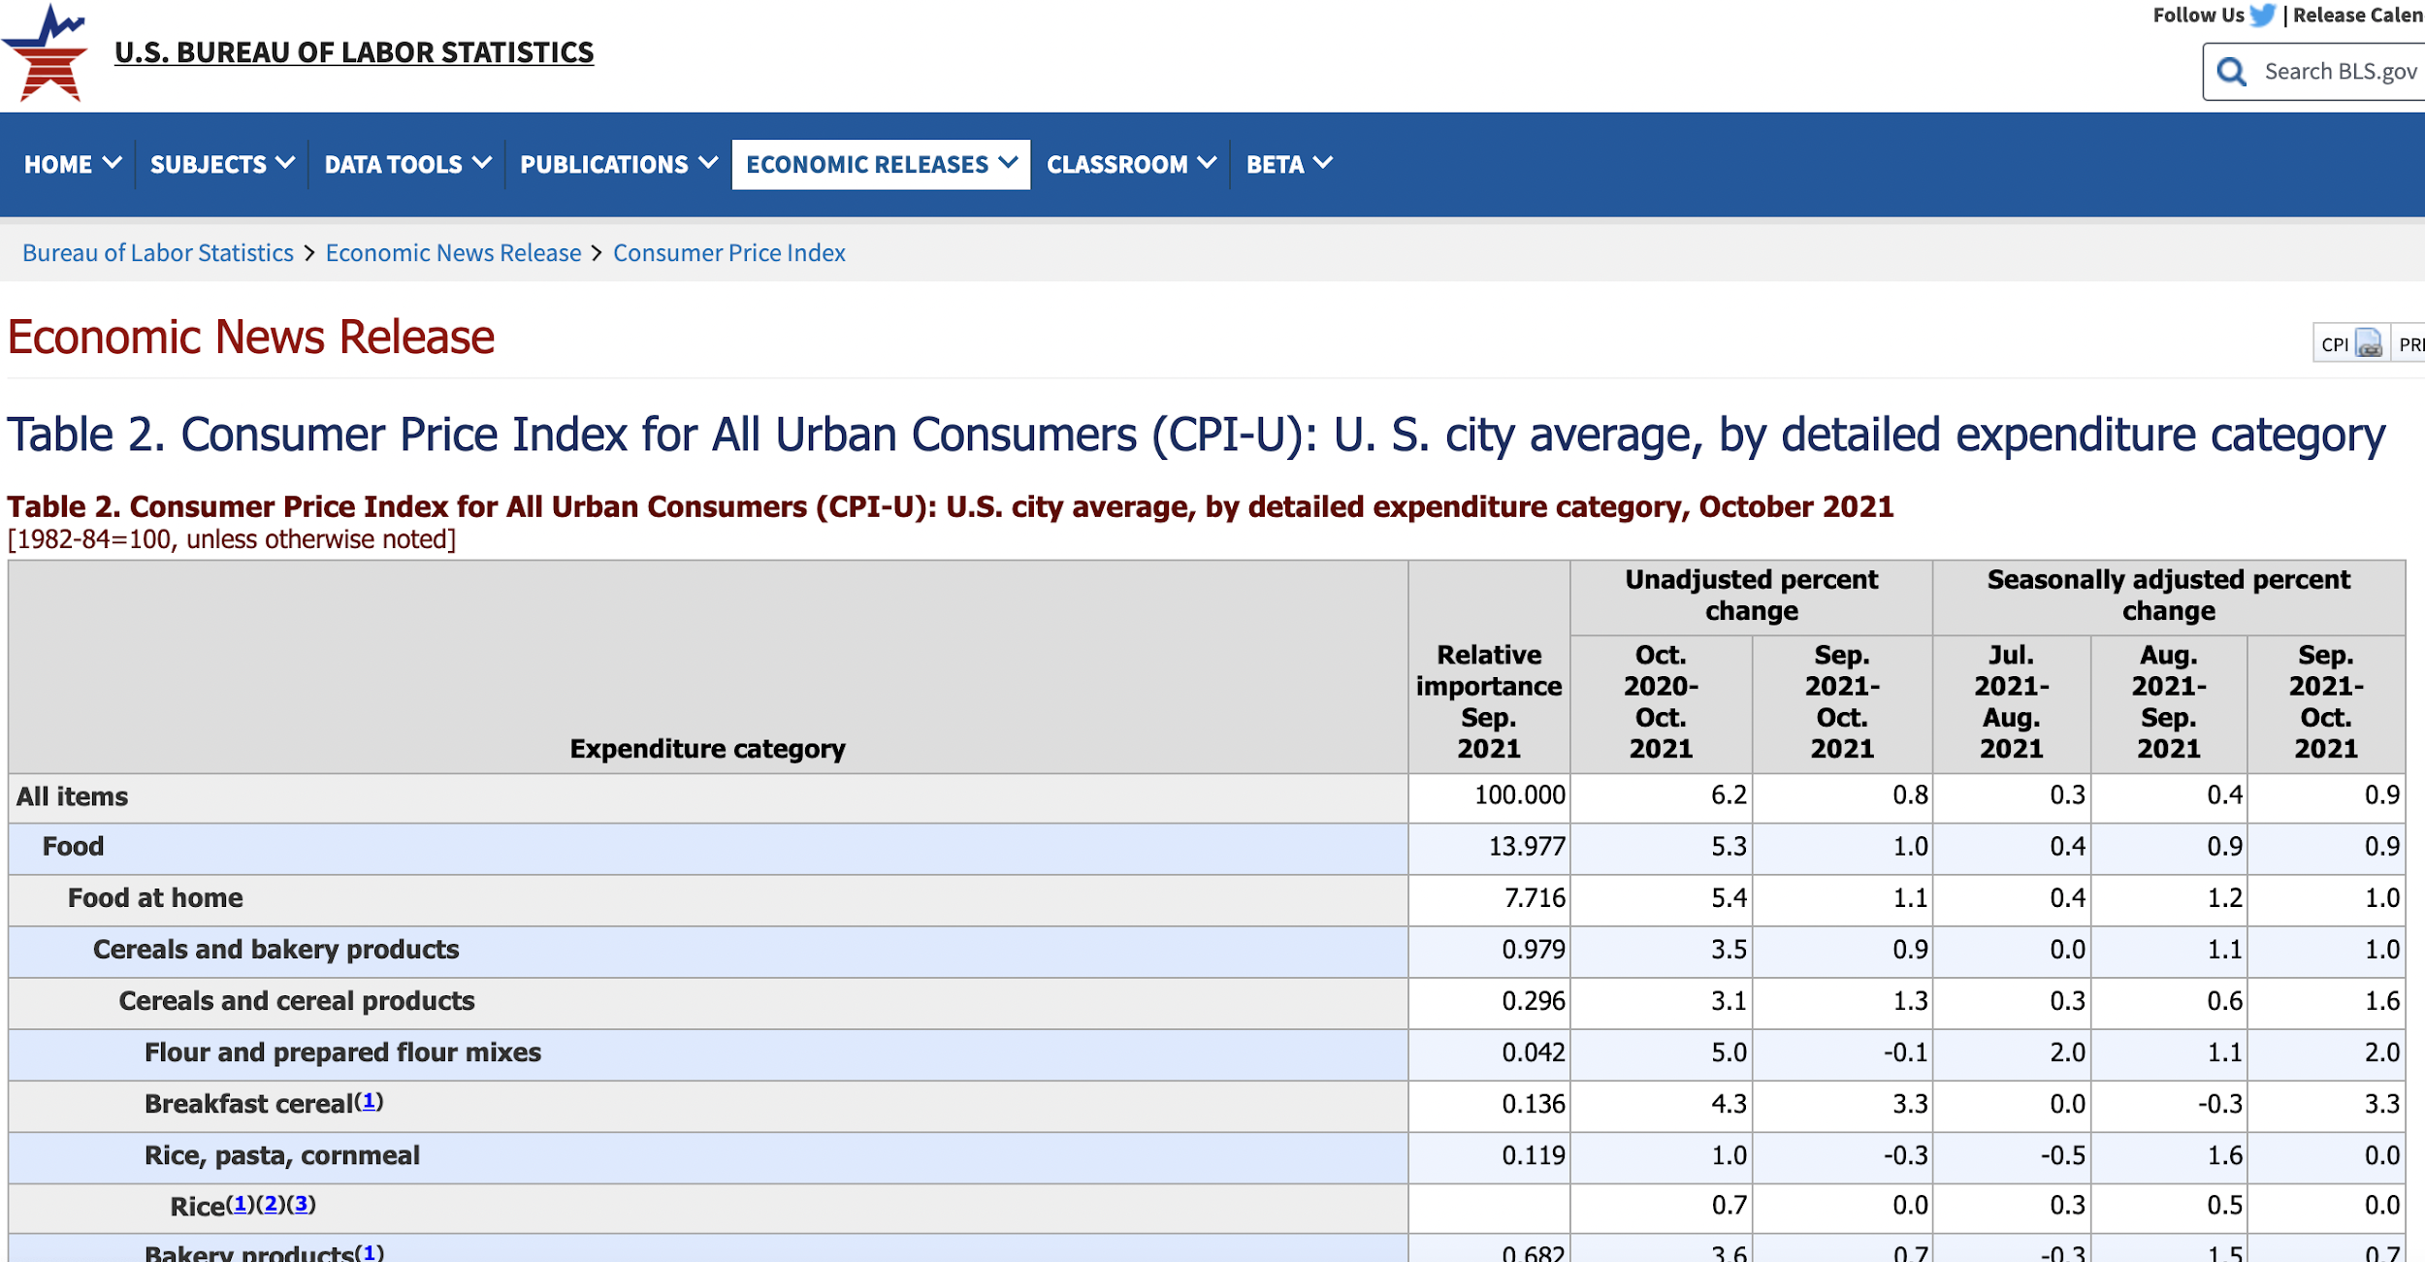
Dataset
Consumer Price Index (CPI)
The Consumer Price Index (CPI) is a measure of the average change over time in the prices paid by consumers for a market basket of consumer goods and services.
The CPI for food measures the changes in the retail prices of food items only.
The most common use of food CPI in the official publications and release tables are the 1-month and 12-month seasonal adjusted and unadjusted percent change in food CPI. For our project, we use 1-month unadjusted percent change in food CPI.

Slide 9







Dataset
seafood
dairy products & eggs
oil
cakes & sweets
fruits
vegetables
cereals
We have CPI for these food subcategories.

Slide 10




Dataset
number of children
region
income
household size
We have food spending for people with these attributes.

Slide 11
Global Perspective
03

Slide 12
Global Perspective
Trend of Food CPI and Covid-19 Statistics
Relation between Covid-19 Trend and Food CPI Trend
Correlation among Food Categories
Further Steps

Slide 13
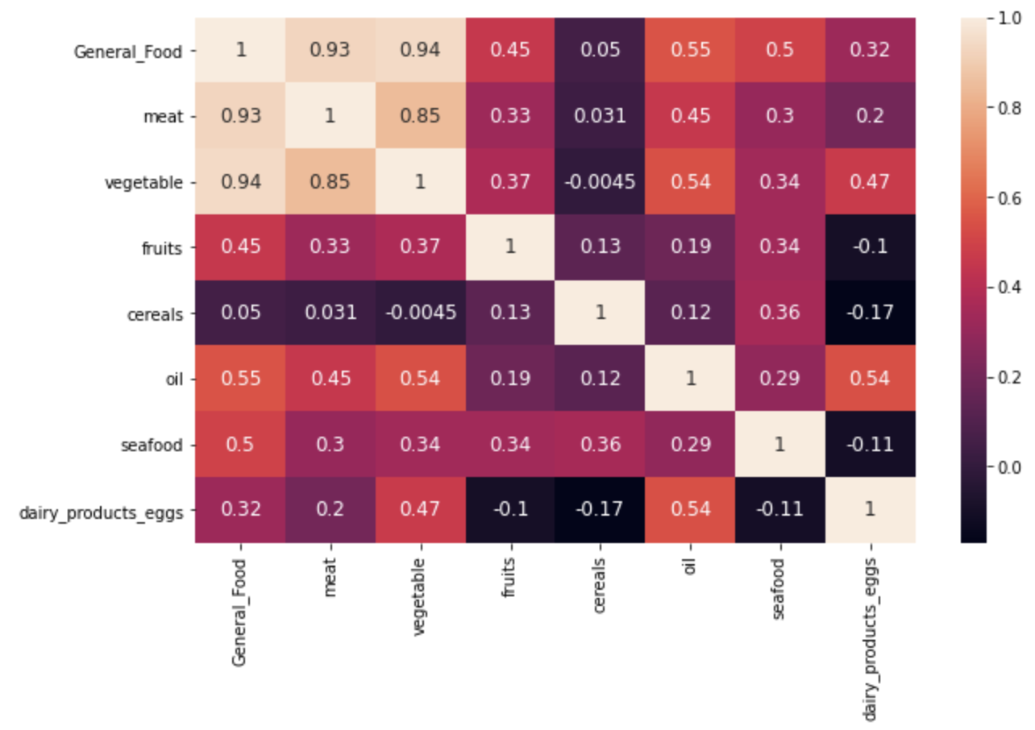
Correlation among Food Categories
CHINA
Meat (0.93) and vegetables (0.94) contribute a lot to the change in food CPI.
Cereals (0.05) rarely contributes to the change in food CPI.
Meat and vegetables have a high positive linear correlation (0.85), which implies that they may be complementary.

Slide 14
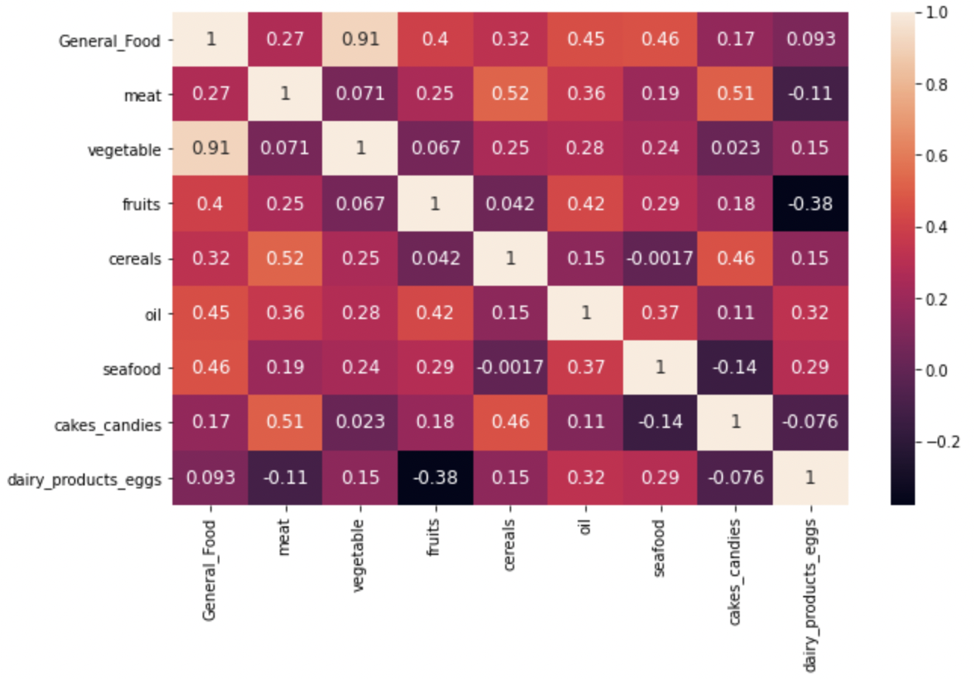
Correlation among Food Categories
JAPAN
Vegetables (0.91) contribute a lot to the change in food CPI.
Dairy products and eggs (0.093) rarely contributes to the change in food CPI.

Slide 15
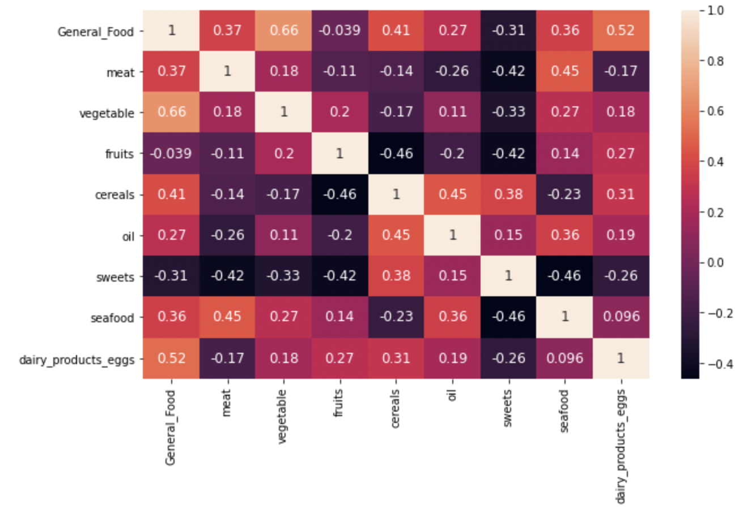
Correlation among Food Categories
UNITED KINGDOM
Vegetables (0.66) contribute relatively a lot to the change in food CPI.
Fruits (-0.039) and sweets (-0.31) rarely contributes to the change in food CPI.

Slide 16
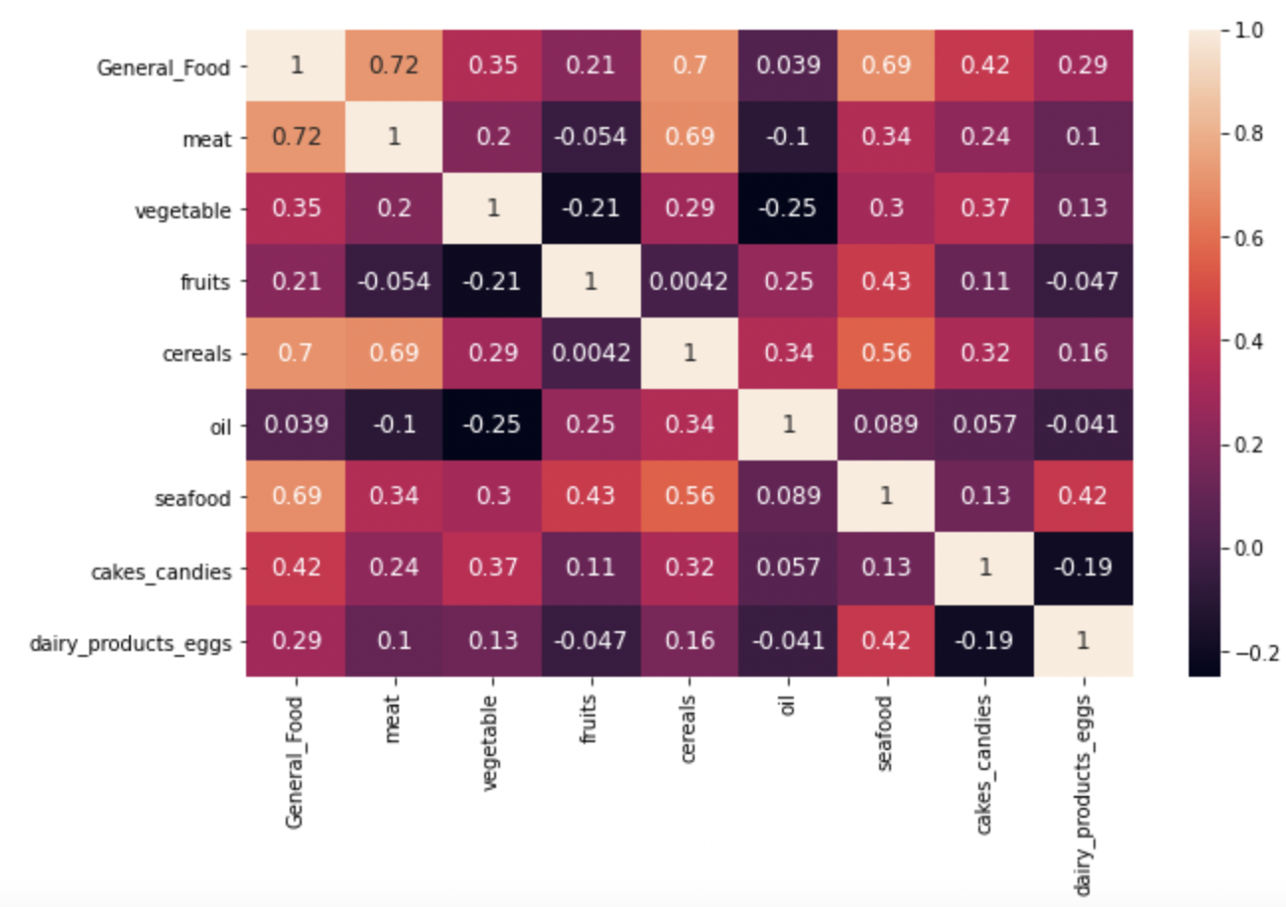
Correlation among Food Categories
UNITED STATES
Meat (0.72), cereals (0.70), and seafood (0.69) contribute relatively a lot to the change in food CPI.
Oil (0.039) rarely contributes to the change in food CPI.

Slide 17
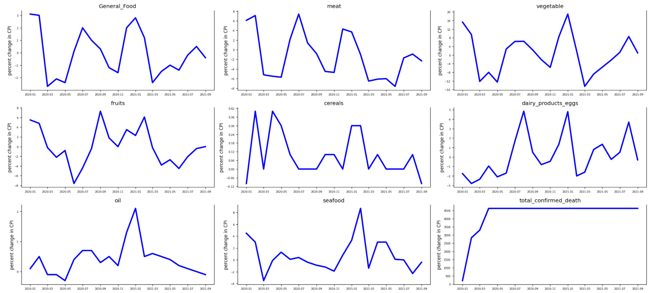
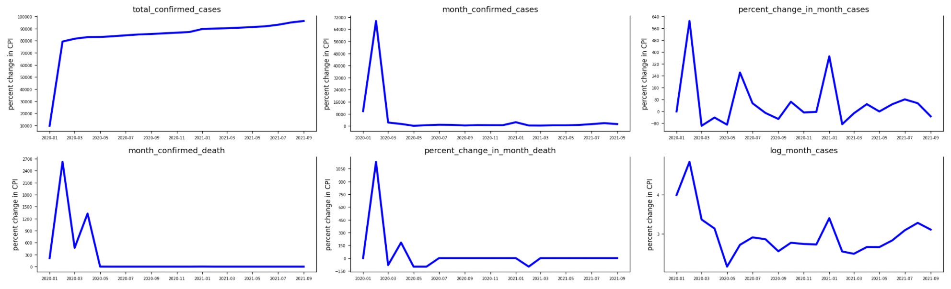
Trend of Food CPI and Covid-19 Statistics
An Overview of Chinese trends

Slide 18
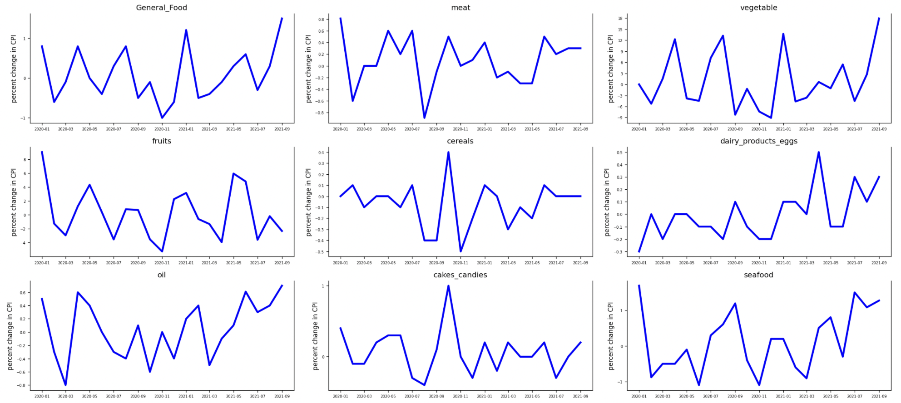
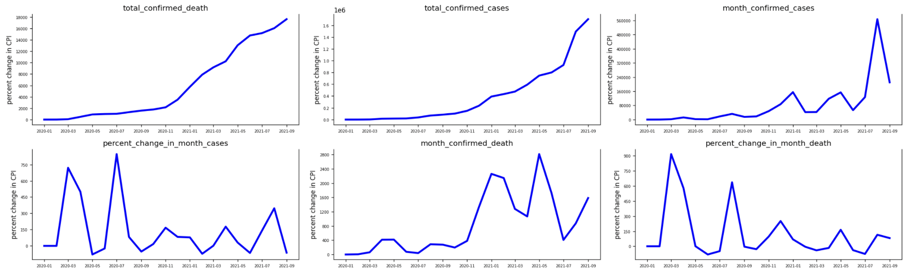
Trend of Food CPI and Covid-19 Statistics
An Overview of Japanese trends

Slide 19
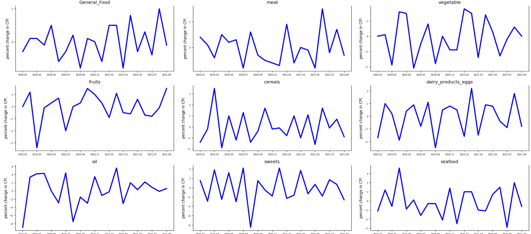
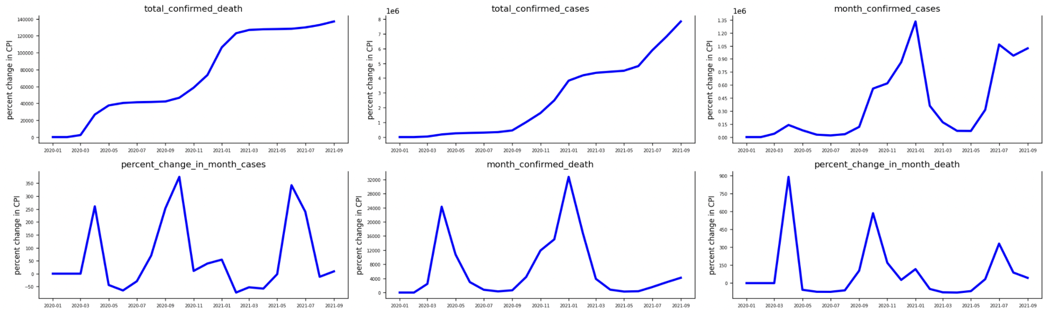
Trend of Food CPI and Covid-19 Statistics
An Overview of UK trends

Slide 20
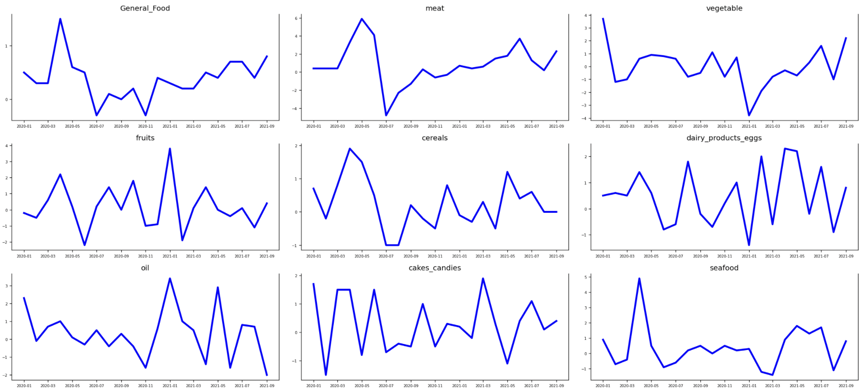
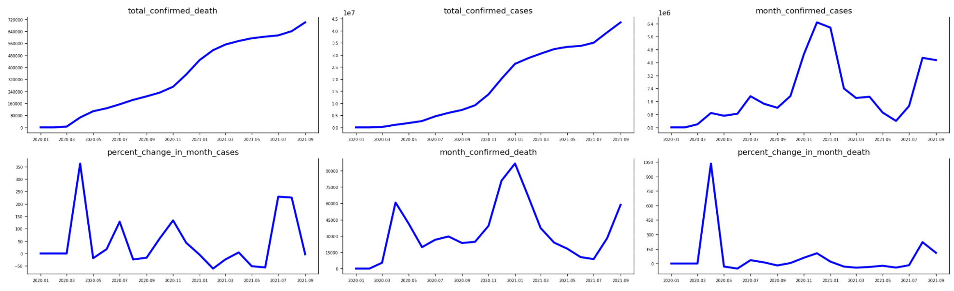
Trend of Food CPI and Covid-19 Statistics
An Overview of US trends

Slide 21


Relation between Covid-19 Trend and Food CPI Trend
Granger Causality

Slide 22


Relation between Covid-19 Trend and Food CPI Trend
Granger Causality
Data Transformation
ADF and KPSS Test
Granger Causality Test
Transform the non-stationary data to stationary data by differencing it
They are two tests for stationary data
Run a granger causality matrix to get all the p_values

Slide 23








Relation between Covid-19 Trend and Food CPI Trend
x: confirmed Covid-19 cases in the previous month
food | meat | vegetables | fruits | cereals | oil | seafood
0.0027 | 0.0248 | 0.0239 | 0.0005 | 0.0105 | 0.0002 | 0.0000
food | vegetables | dairy products & eggs | oil
0.0015 | 0.0107 | 0.0000 | 0.0048
food | vegetables | dairy products & eggs
0.0001 | 0.0189 | 0.0468
oil | cereals
0.0001 | 0.0406

Slide 24

Relation between Covid-19 Trend and Food CPI Trend
Conclusions

Slide 25
Further Steps
Find stronger evidence of the similarity of CPI trend for food subcategories (i.e. vegetables, meat, fruits, etc) and relate the similarity to policies
Include more countries

Slide 26
Local Perspective
04

Slide 27
Local Perspective
Trend of food spending and Covid-19 statistics
Relation between food spending and CPI trend
Food CPI changing over time
Further Steps

Slide 28
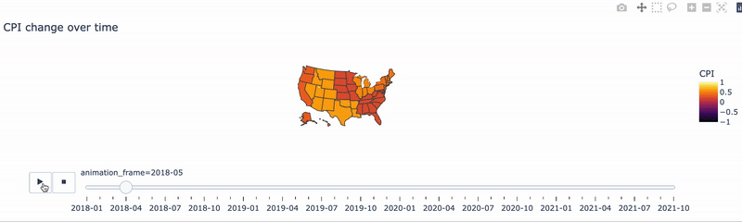
Food CPI changes over time
CPI based on Census division
CPI changes overtime

Slide 29
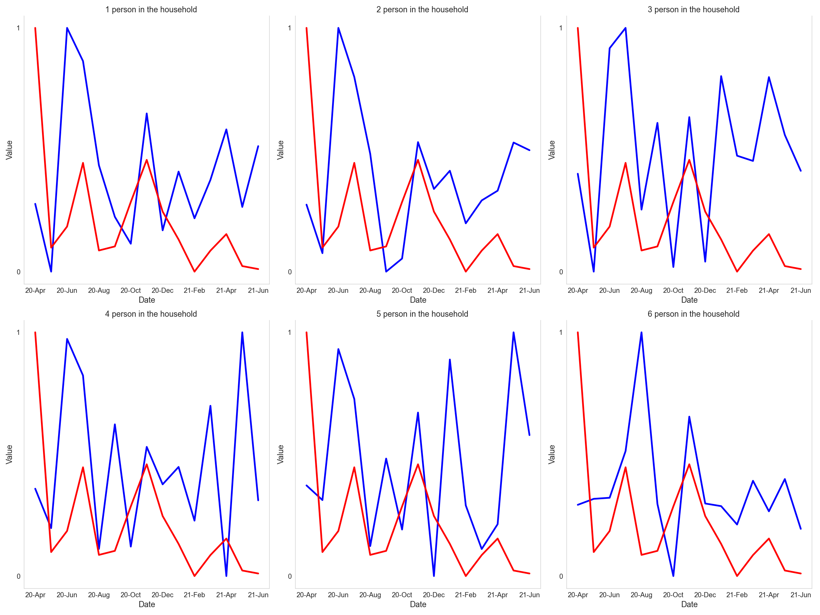
Trend of Food Spending and Covid-19 Statistics
An Overview of “Household Size” trends

Slide 30
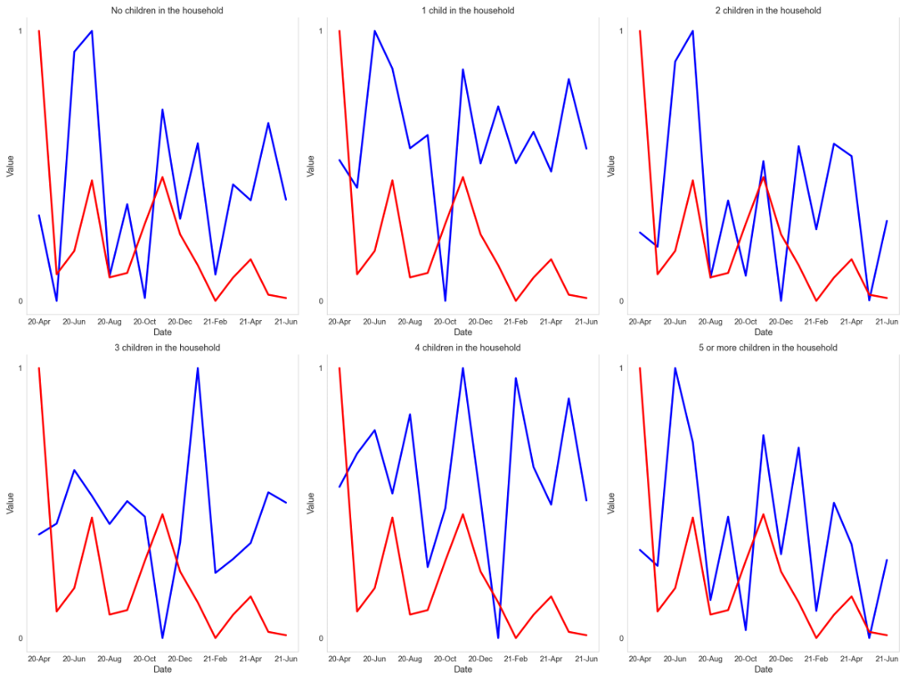
Trend of Food Spending and Covid-19 Statistics
An Overview of “Children Num” trends

Slide 31
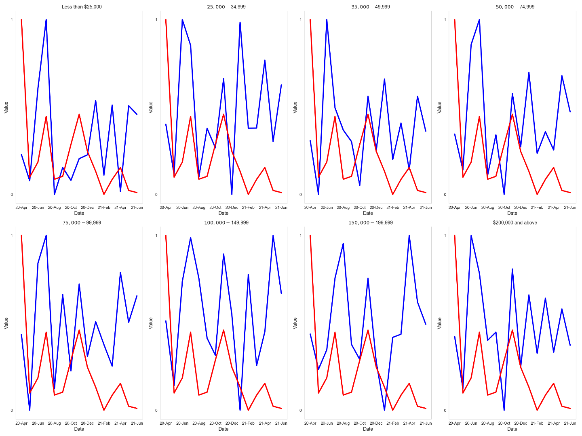
Trend of Food Spending and Covid-19 Statistics
An Overview of “Income” trends

Slide 32

Relation between Food Spending and CPI Trend
x: monthly food cpi changes
y: monthly food spending changes
No children in the household | 1 child in the household | 2 children in the household | 3 children in the household | 4 children in the household | 5 or more children in the household
0.0000 | 0.0000 | 0.0653 | 0.0069 | 0.7414 | 0.0282
The food spending of household with 2/4 children is less impacted by food price changes

Slide 33
Relation between Food Spending and CPI Trend
x: monthly food cpi changes
y: monthly food spending changes
Less than $25,000 | $25,000−34,999 | $35,000−49,999 | $50,000−74,999 | $75,000−99,999 | $100,000−149,999
0.0006 | 0.0085 | 0.0004 | 0.0069 | 0.0000 | 0.0001
$150,000−199,999 | $200,000 and above
0.3482 | 0.1555
People with more income care less about the food price!

Slide 34
Further Steps
Compare food spending at home and far away from home for different households
Include more attributes

Slide 35
THANK YOU !

